Slide 1
Piss and INK
Ethan Yandow
Chris Esposito

Slide 2
Piss and INK
Introduction
Template
Backend Overview
Frontend Overview
Openfire
Use Cases
API

Slide 3
What is Piss and INK?
Python Django web application
Module based- Everything is a plugin module
Extensible- Can load additional community plugins
XMPP API
Works across a large variety of devices
Multiuser on a small scale

Slide 4
What is Piss and INK? (Cont.)
Piss(Python Information and Scheduling system) & INK
Piss & INK was designed to be:
  Multiuser on a relatively small scale
  Extensible
  Centralized
  Security is not a primary concern

Slide 5
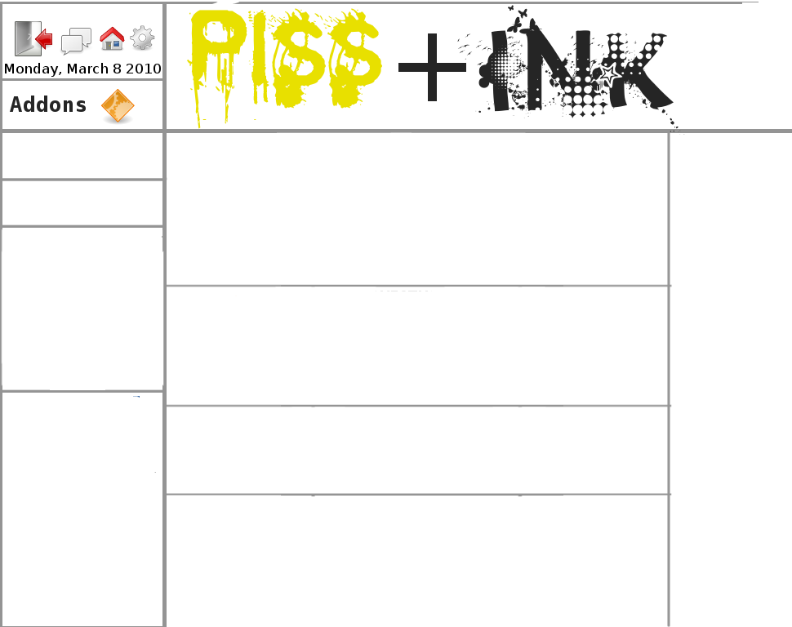
Template

Slide 6
Backend overview
Uses Django to insert our modules into a template
Modules settings are stored in a MySQL database
Backend can connect directly with MySQL
XMPP API provides communication with modules to interact with modules
TBD

Slide 7
Frontend overview
Modules are arranged and rearranged in the template with CSS
Some modules provide a popup for additional functionality, or can load full pages.
Javascript / Jquery provides effects required by some modules.
Uses HTML5 and CSS3 where possible.

Slide 8
Openfire
  Backend only has client
  Openfire is used for the XMPP server
  Java based
  Uses self-signed, or CA signed certificates to encrypt connections
  Users are authenticated to the Piss & INK DB rather than the Openfire database

Slide 9
Basic Use Cases
Loading a module
Adding friends
Installing modules

Slide 10
API
Adding an event with the XMPP API
<message
to='kyle.butler@pissandink.com'
from='kyle.butler@jabber.com/kitchen'
type='event'
<subject>[ADD]Event title</subject>
<body>[DATE]1/2/03 18:00:00 [DESC]Dinner at Arthur Mitchell's</body>
<thread>e0ffe42b28561960c6b12b944a092794b9683a38</thread>
</message>

Slide 11
API (cont.)
Some security
<message to='wronguser@domain.com'>
type='chat'
<subject>Error</subject>
<body>User wronguser@domain.com not authorized to use this server.</body>
</message>

Slide 12
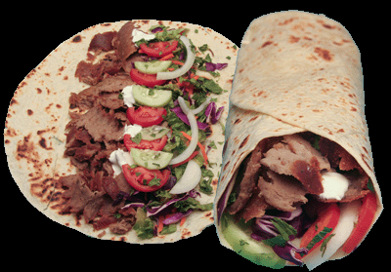
Questions

